Slide 1
Robot final version
Xiangxu Lin

Slide 2
Tutorial step
1: video stream from raspberry pi
2: process video on other PC (anything but raspberry pi)
3: line detector and follow
4: object detector: speed limit, traffic light, stop sign
5: draw a map
6: point to point drive
7: Voice control

Slide 3
Video stream
Using the code in Video_Stream folder, professor give to us.
Reduce the resolution to 144 X 256, in order for video to smoth
Raspberry Pi: Run main.py, setup a connection, send video through web server
Other Working PC: use thread module getting video from web server and complete the connection

Slide 4
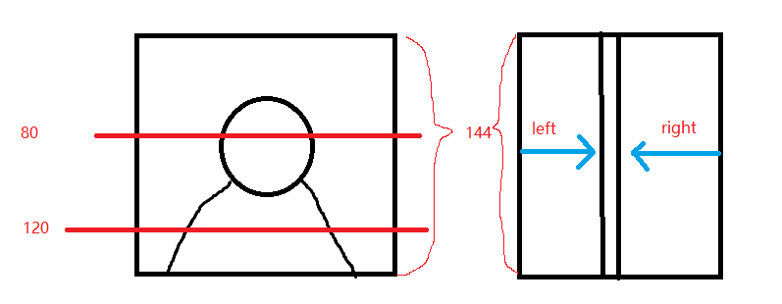
Line detection

Slide 5
Line Detection
As shown on the picture 1, you can determine each pixel of line by simply call the img[linenum] to get the result
Under edge detection, it shows the value of edge as 255, others as 0
In order to determine the line on the capture video, we can simply check left and right pixel, see at which position they reach value 255 first. Cross compare over different linenum position on video,

Slide 6
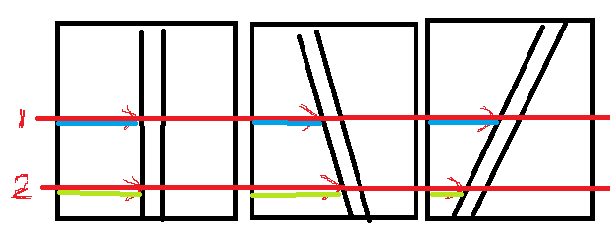
Line detection
Compare the length of blue and green line, and you can see the direction

Slide 7

If car is detect line is straight, keep moving, if detect line is turning left (car on the right side of line), just simply turn left, if line is turning right, simply turn left.

Slide 8
Object detection (speed limit, stop sign)
By using knnMatch() function to do template comparison.
Define different threshold for different object.
Note: for unknown reason, the knnMatch() did not like traffic light, it can not detect traffic light template

Slide 9

Object detection (traffic light)
Traffic light got 1 rectangle, 3 circle, 1 red color, 3 grey color, and black color
We can use all the property to define a traffic light on opencv, but it would simply too much information and slow down the image process
I am using 3 circle, 1 red color to define traffic light on opencv by check the number of circle and the color display on the image.
Note: to distinguish the different between red traffic light and stop sign. Traffic light has 3 circle.

Slide 10
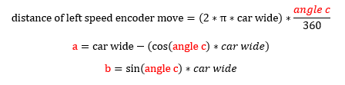
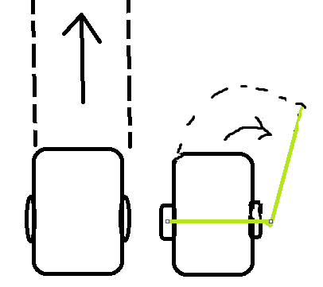
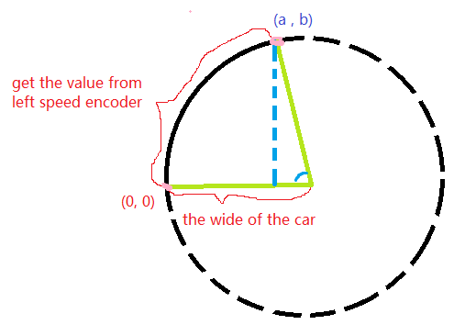
Draw a map

Slide 11
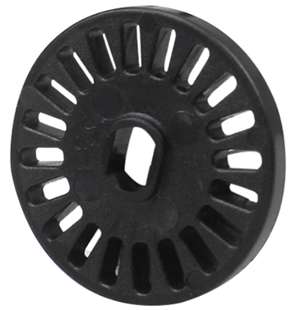
Draw a map
Using speed encoder to get the distance of travel and recode each coordinate
Start at(0, 0), using the algorithm at previous slide, add value to it on two condition:
1. If line is straight, add value every seconds.
2. If line is turning, add value before and after each turn
Import all the value as list, using matplotlib to draw the path

Slide 12
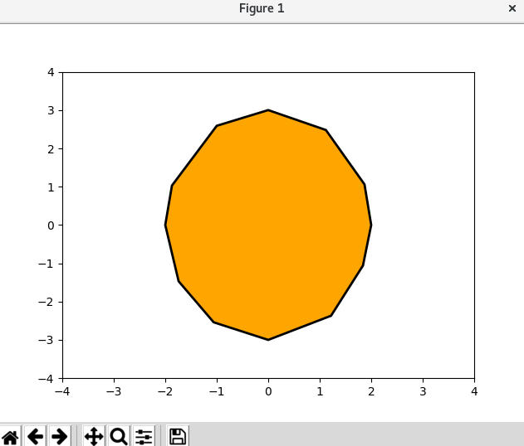
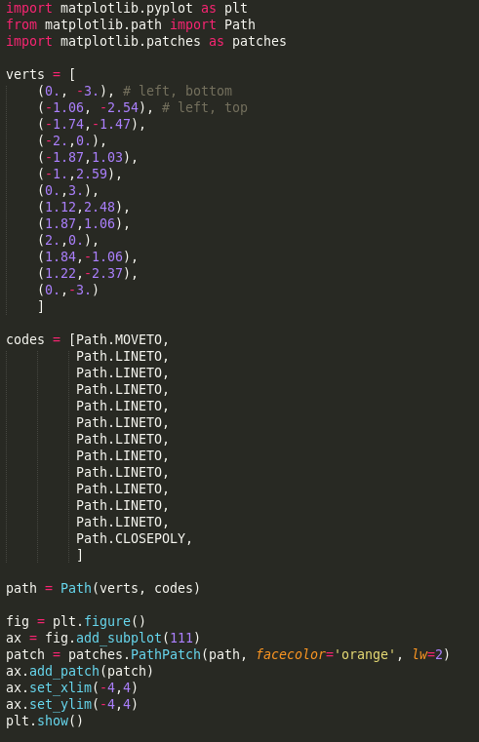
Draw a map

Slide 13
Point to point drive
Set trackback using the map we create.
Set start point as (0, 0)
Using the previous algorithm to calculate the angle between each two points, if angle is 0, means line is straight, then moving straight, if angle is not straight, depending the direction, turn left or right of the distance between two points,

Slide 14
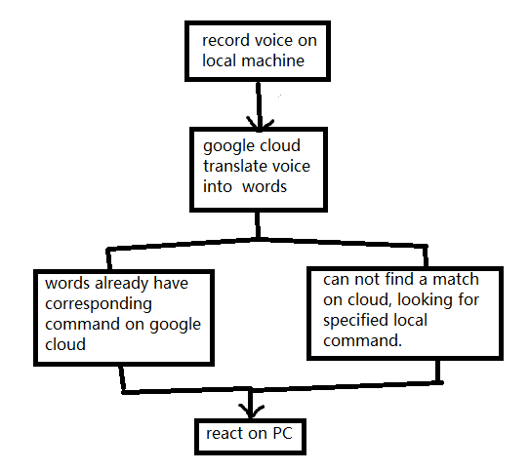
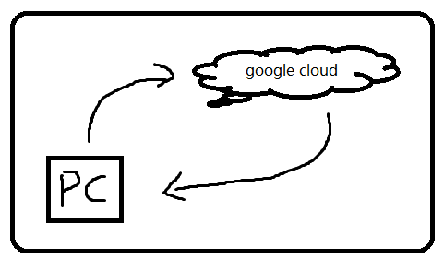
Voice control

Slide 15
Voice control
we are using the google assistant voice control server
set up a mic and speak on raspberry
https://developers.google.com/assistant/sdk/guides/library/python/
2. download the AIY project provided by google and set it up on your raspberry (there is a git link, you can download the whole project)
https://aiyprojects.withgoogle.com/voice-v1/
(if you have Voice HAT, follow the HACKING.md to set up, if not, follow the instruction below)
3. download all the dependency in requirement.txt, and run the demo on /src/example/voice/assistant_library_demo.py. ( it may ask you install one or two more dependency)
4. DIY your own local command , take a look at assistant_library_with_local_command.py, all the things you need to modify will be in there

